Slide 1
Target Sales Project
Completed By Tanmay Chakraborty

Slide 2
Problem Statemen
I have historical sales data for 45 stores located in different region search store contains a number of departments. The company also runs several promotional markdown events throughout the year. These markdowns precede prominent holidays, the four largest of which are the Super Bowl, Labor Day, Thanksgiving, and Christmas. The weeks including these holidays are weighted five times higher in the evaluation than non-holiday weeks.
One challenge of modeling retail data is the need to make decisions based on limited history. Holidays and select major events come once a year, and so does the chance to see how strategic decisions impacted the bottom line. In addition, markdowns are known to affect sales the challenge is to predict which departments will be affected and to what extent.

Slide 3
About the Dataset
We have 3 three csv files for this Project.
First Csv Name is Business_data.csv which has Store,Date,Temperature,Fuel_Price,MarkDown1,MarkDown2,MarkDown3,MarkDown4,MarkDown5,CPI,Unemployment_Rate,Holiday columns and the dataset has 8190 rows.
Second Csv Name is Sales_History.csv which has Store,Department,Date,Total_Sales,Holiday columns and the dataset has 421570 rows.
Third Csv Name is Store_details.csv which has Store,Type,Address,Area_Code,Location,Size columns and the dataset has 45 rows.

Slide 4
Little Discussion on Missing Value and Outlier
In the dataset Markdown columns have mostly missing values and it has the reason of missing because on that date that store has not given any amount in markdown so I replaced those nulls with 0 and after that in the column cpi and unemployment rate has some null values but based on the size of the data at the last I dropped those because it may not affect the data and in the case of outliers dataset has not that much outlier in the data so I did not handle it.

Slide 5
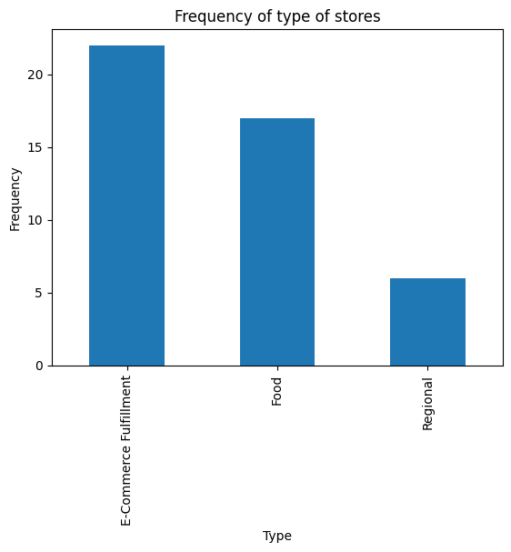
Descriptive Statistics of the data
In the data there are 3 store type Ecommerce-Fullfillment, Food, Religion .

Slide 6
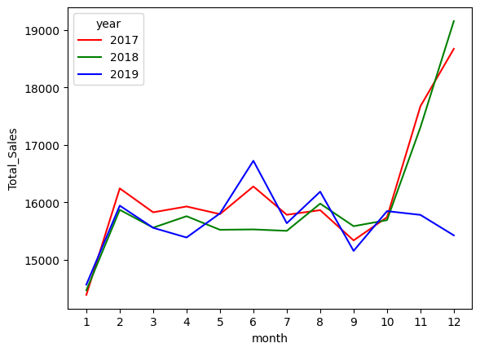
Descriptive Statistics of the data
In the below graph we can see almost the same trend in months on year 2017,2018,2019 and after 10 th month we can see a high pick in the year of 2017 and 2018 but in 2019 we can decrease of sales. The reason behind the increment of sales after 10th month is that after that month people get holidays from their work so they get time to buy more products and this is the reason of the trend.

Slide 7
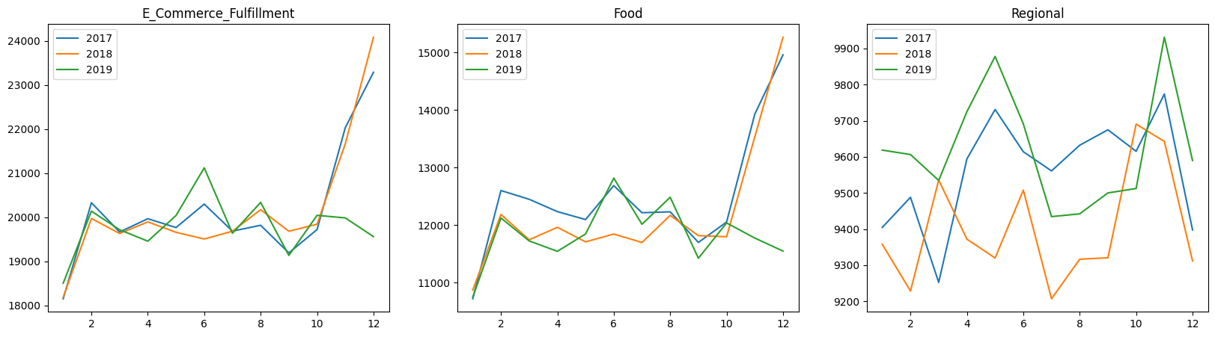
Descriptive Statistics of the data
If we can see a same pattern for both ecommerce and food store types but in the case of regional store that trend is bit different we can see the pick of sales more times compare with other tow but in the month between 4 and 6 we can see a high peak and between 10 and 12 we can high peak in the data.

Slide 8
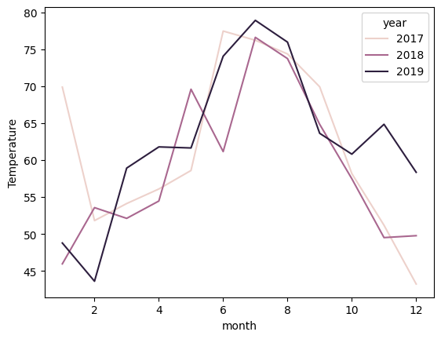
Descriptive Statistics of the data
From the below graph of temperature fluctuations based on month and year we can se that in the year of 2019 the temperature after 10th month is quite high compare to other two temperature this might be the reason of less sales which we have seen in our previous slide.

Slide 9
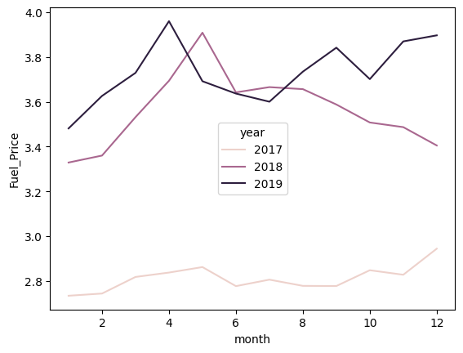
Descriptive Statistics of the data
From the below graph of fuel price fluctuations based on month and year we can se that in the year of 2019 the fuel price after 10th month is quite high compare and the overall year also it was quite high to other two year prices this might be the another reason of less sales which we have seen in our previous slide.

Slide 10
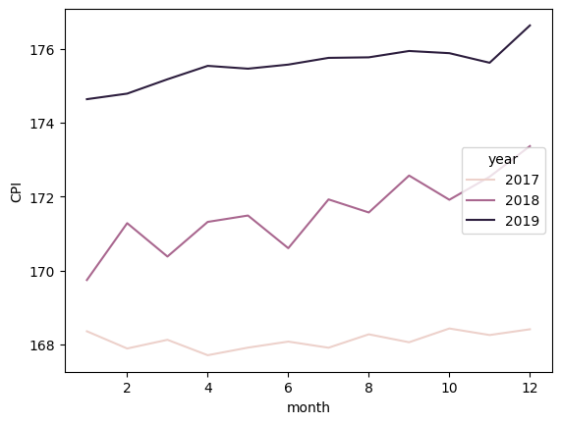
Descriptive Statistics of the data
From the below graph of cpi rate we can see the drastic change based on year and 2019 has high cpi rate ad after the 10th we can again see the peak of cpi .

Slide 11
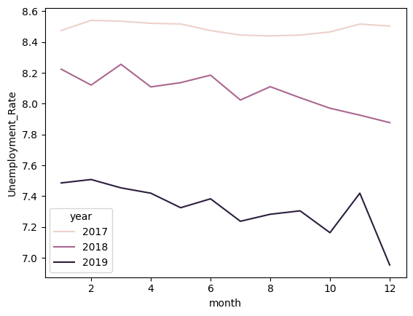
Descriptive Statistics of the data
Here we can see the unemployment rate was down on 2019 compare to other years

Slide 12
Model Building
I have to predict the sales based on the independent features of my data. Now before that I applied clustering on my data and based on wcss plot I have decided to take 3 clusters and I checked the silhoutee score to decide which algo will be better to use for clustering. I have selected kmeans here.
Based on 3 cluster I have applied Linear Regression, Lasso, Ridge, Elasticnet, Support Vector Regressor and Decision Tree Regressor and Knearest Neighbour.
Now on the first cluster Markdown 3 and 4 have a positive impact only and other markdown have negative impact on sales.
On Second cluster Markdown 2,3,4,5 have positive impact except Markdown1
On Third cluster Markdown 1,2,3,5 have positive impact except Markdown4

Slide 13
Model Details
I used Linear Regression for my First Cluster which has given me 69% training accuracy and 71% testing accuracy and then I tried to apply Lasso also gave almost the same accuracy but I tuned my params also using cross validation. Ridge gave me 58% training and 60% testing accuracy then elastic net was not able to work well so I ignore it and applied svr but it was not working well then I used decision tree regressor and I tried to apply grid search cv their to get optima; parameter and I used for my model max_depth=6,min_samples_split=20,min_samples_leaf=20,max_leaf_nodes=7,max_features=0.8 and got 72% training and 70% testing accuracy and last I applied knn with n neighbors 4 and algorithm = “brute” I got 93% training and 86% testing accuracy.

Slide 14
Model Details
I used Linear Regression for my First Cluster which has given me 71% training accuracy and 54% testing accuracy and then I tried to apply Lasso,Ridge also gave almost the same accuracy but I tuned my params also using cross validation then elastic net was not able to work well so I ignore it and applied svr but it was not working well then I used decision tree regressor and I tried to apply grid search cv their to get optima; parameter and I used for my model max_depth=3,max_leaf_nodes=7,max_features=0.9,random_state=0 and got 67%training and 51% testing accuracy and last I applied knn with n neighbors 4 and algorithm = “auto” I got 93% training and 86% testing accuracy.

Slide 15
Model Details
I used Linear Regression for my First Cluster which has given me 48% training accuracy and 55% testing accuracy and then I tried to apply Lasso,Ridge also gave almost the same accuracy but I tuned my params also using cross validation then elastic net was not able to work well so I ignore it and applied svr but it was not working well then I used decision tree regressor and I tried to apply grid search cv their to get optima; parameter and I used for my model max_depth=4,max_leaf_nodes=7 and got 62% training and 57% testing accuracy and last I applied knn with n neighbors 4 and algorithm = “auto” I got 74% training and 45% testing accuracy. Here it was overfitted I tried to tune but it was not changing and I just ignore this one so I have to select the model with less accuracy since the dataset length of this cluster is not that much so I select the highest testing accuracy once.

Slide 16
Difficulties
During training it was some issue regarding selecting cluster because dataset has a different silhoutee score for different clustering algorithms. But I tried to select the best one then while doing the training the decision tree model was overfitted so I have to tune it a lot because just only doing the grid search cv model was not working well so I tried to put some values by myself to check when accuracy dropped or increased as well as model becomes overfitted also and that is the dangerous problem in decision tree I faced.

Slide 17
Conclusion
From the overall view I can say that because of temperature high customers are not coming for shopping when they are on leave but the fuel price and temperature affected the sales in the year of 2019. SO stores have to low cost their prices as well as cpi also. Based on these factors they have to decide the price of their product especially after the month of 10th in upcoming years. For regional store type case they have a high sales on 4 and 6 month also so at that time they might give some more discount to catch people before 10th month also by this if temperature affects after 10th they don’t have to worry that much.

Slide 18
Thank You

